Slide 1
XII Standard
Computer Science
Chapter-13
Python and CSV Files

Slide 2
CSV file with default delimiter comma(,)

Slide 3
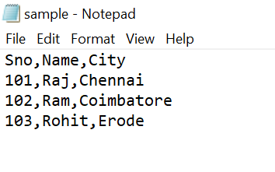

Slide 4


Slide 5
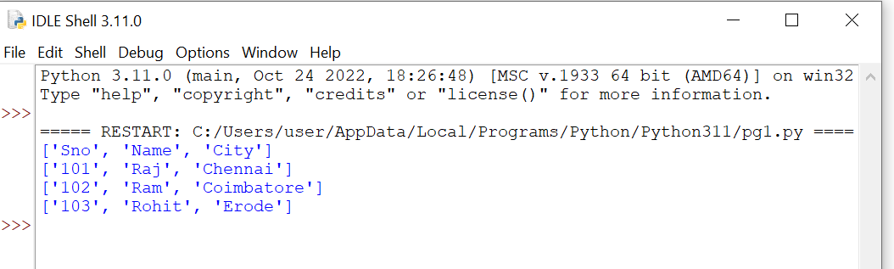

Slide 6
CSV file-data with Spaces at the beginning

Slide 7
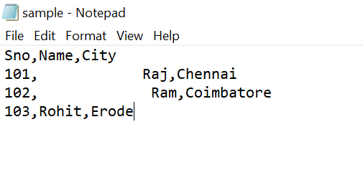

Slide 8
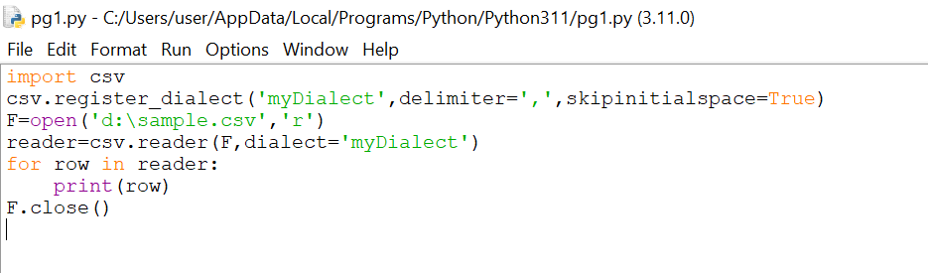

Slide 9


Slide 10
CSV file-data with Quotes

Slide 11
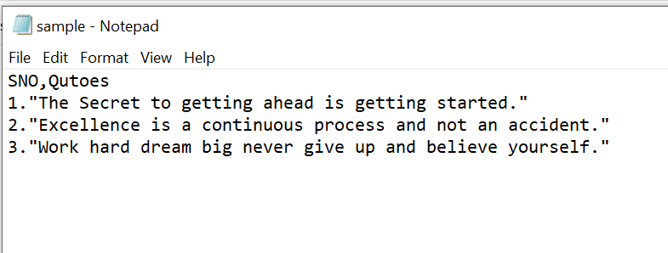

Slide 12
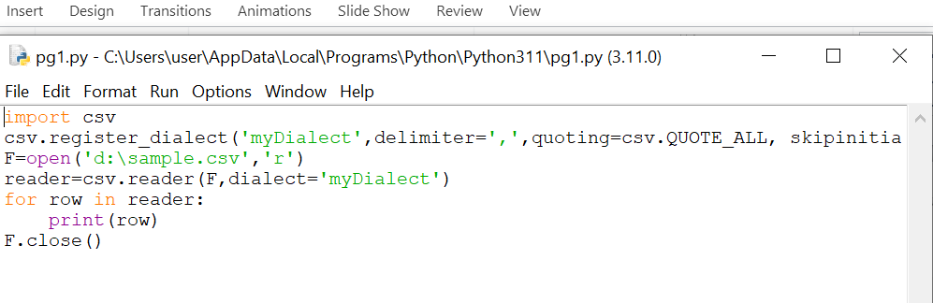

Slide 13
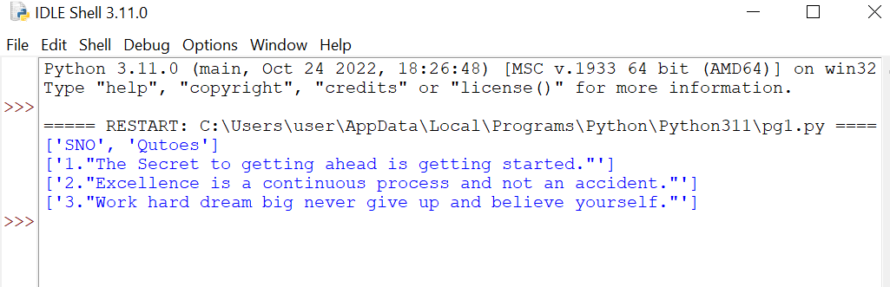

Slide 14
CSV file-data with Custom Delimiters

Slide 15
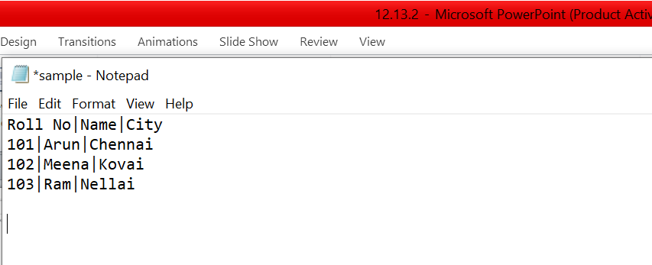

Slide 16


Slide 17
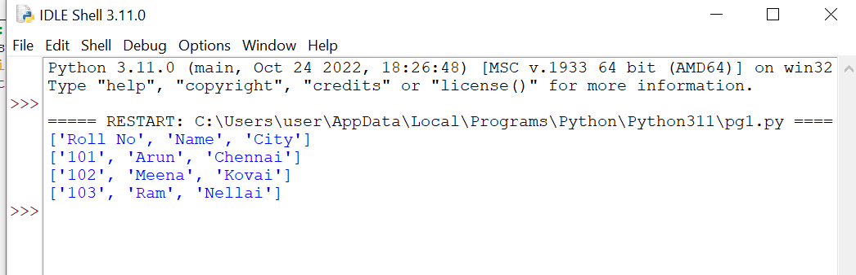

Slide 18
Read a specific column in a file

Slide 19
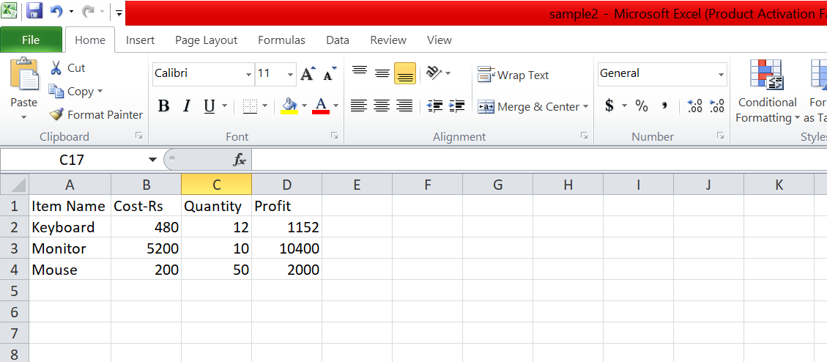

Slide 20
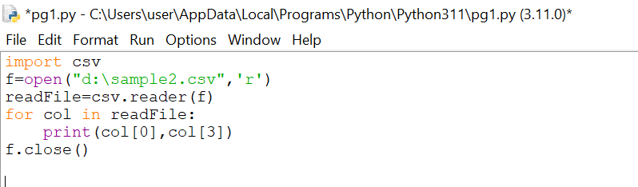

Slide 21
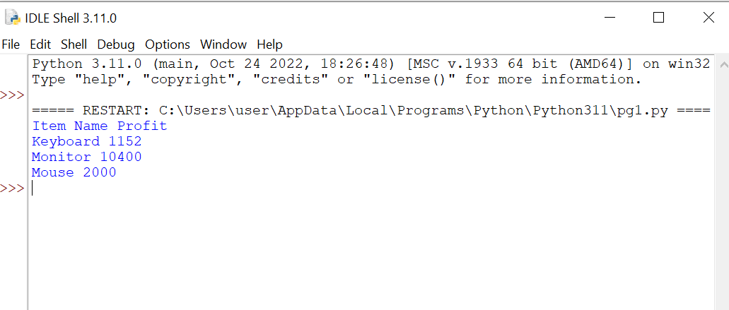

Slide 22
Read a CSV file and store it in a list

Slide 23
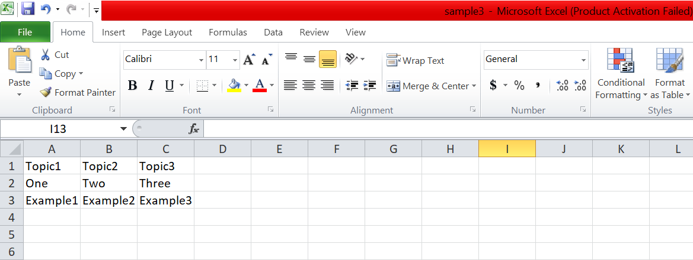

Slide 24


Slide 25
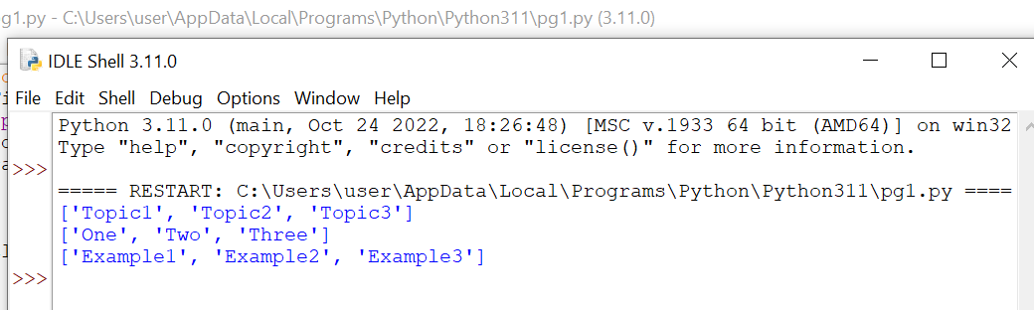

Slide 26
Read a CSV file and store a column value in a list for sorting

Slide 27
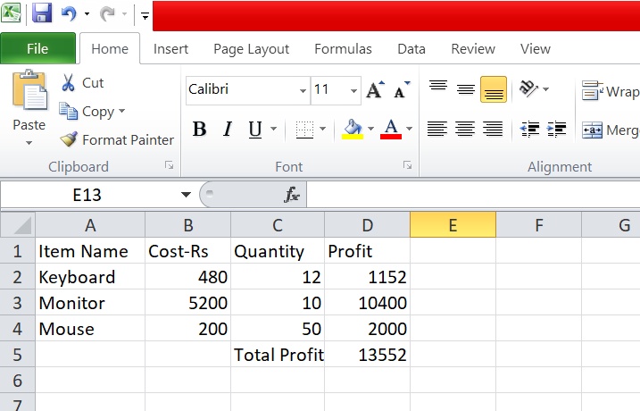

Slide 28


Slide 29


Slide 30
Sorting a CSV file with a specified column

Slide 31
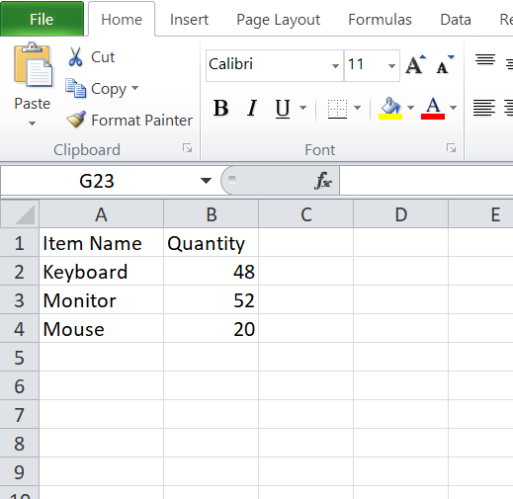

Slide 32


Slide 33


Slide 34
Reading a CSV File into a Dictionary

Slide 35


Slide 36
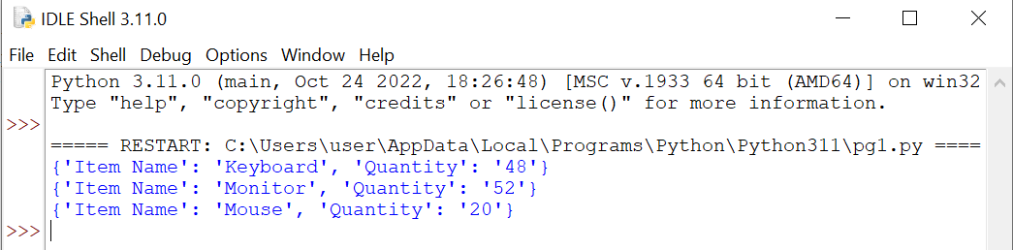

Slide 37
Reading a CSV File with User Defined Delimiter into a Dictionary

Slide 38
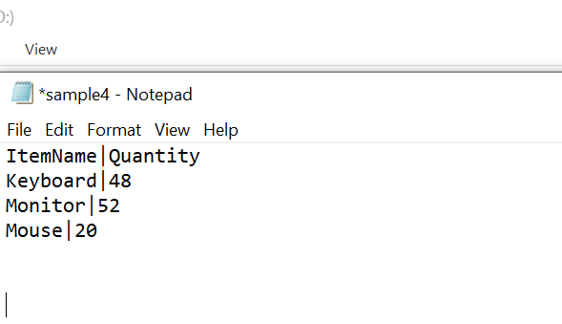

Slide 39


Slide 40


Slide 41
Thank You

